Slide 1
Min – Max Problem

Slide 2
Min – Max Problem
Finding the maximum and minimum elements in a set of (n) elements.
The straightforward algorithm.
Input: array (a) with (n) elements
Output: max: max value, min: min value
Algorithm straightforward (a, n, max, min) {
max:= min:= a[1]
for i := 2 to n do{
if (a(i)>max) then max:=a[i]
else if (a(i)<min) then min=a[i] }
}

Slide 3
Min – Max Problem – Straight Forward Approach
best case: elements in increasing order
No. of comparisons = (n-1)
Worst case: elements in decreasing order
No. of comparisons = 2(n-1)
Time Complexity = O(n)

Slide 4
Min – Max Problem – Divide & Conquer Approach
Function Min_Max(int a[],int lb,int ub,int *min,int *max) {
int n,mid,min1,min2,max1,max2;
if(lb==ub)
{ *min=a[lb];
*max=a[lb];
}
else
{ mid=(lb+ub)/2;
Min_Max (a,lb,mid,&min1,&max1);
Min_Max (a,mid+1,ub,&min2,&max2);
if(max1>max2)
*max=max1;
else
*max=max2;

Slide 5
Min – Max Problem – Divide & Conquer Approach
if(min1<min2)
*min=min1;
else
*min=min2;
}
}

Slide 6
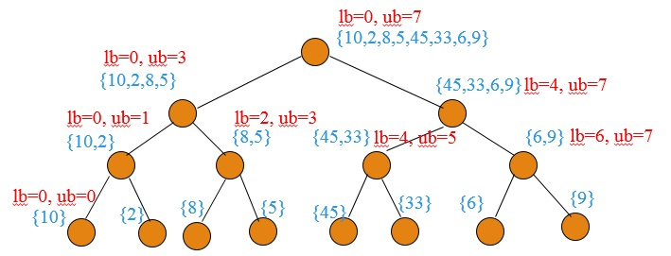
Min – Max Problem – Divide & Conquer Approach
Illustration of Max_Min Function on array = {10,2,8,5,45,33,6,9}

Slide 7
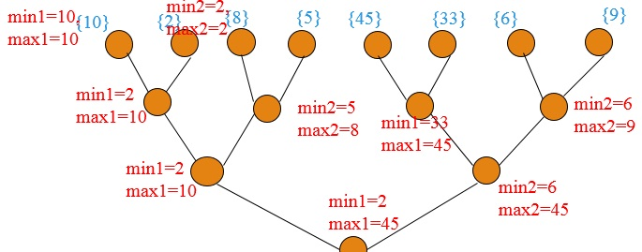
Min – Max Problem – Divide & Conquer Approach
Illustration of Max_Min Function on array = {10,2,8,5,45,33,6,9}

Slide 8
Min – Max Problem – Divide & Conquer Approach
Recurrence Relation:
T(n) = 2T(n/2) + Ө(1) , n>2
Solve above recurrence using master theorem,
we get t(n) = n.

